Slide 1
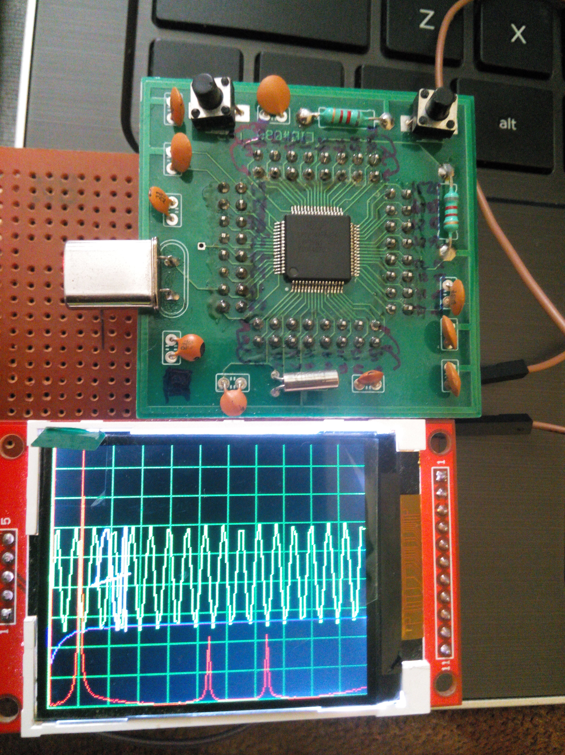
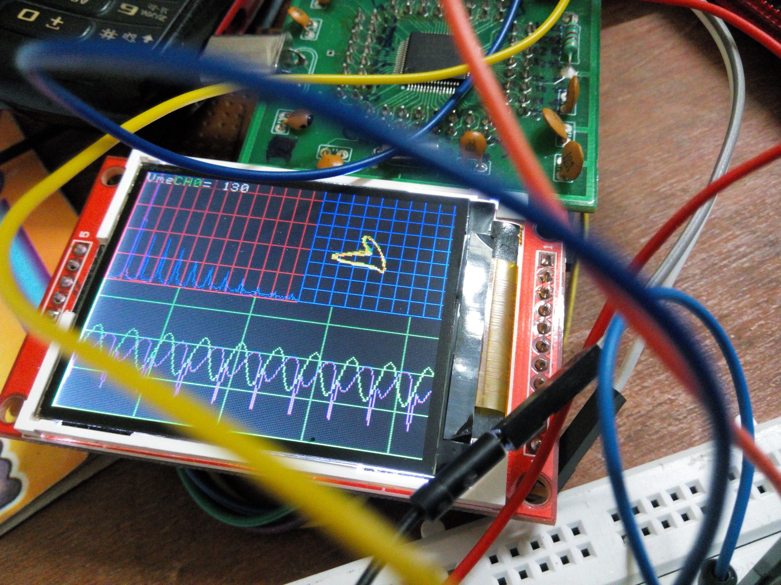


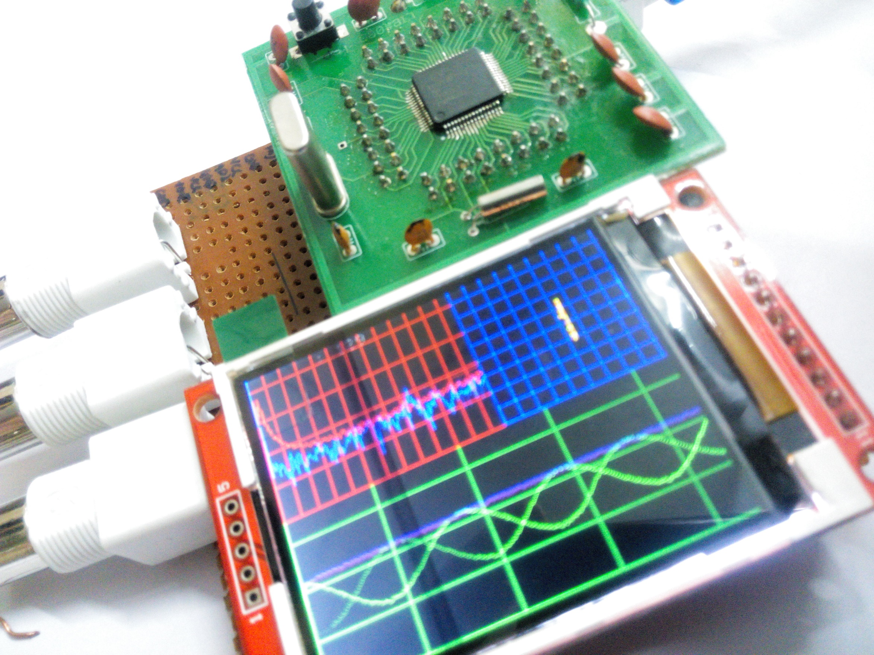
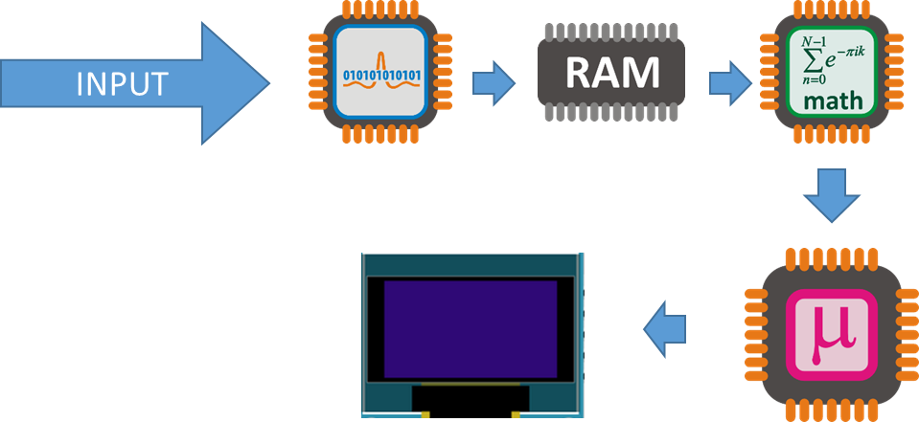

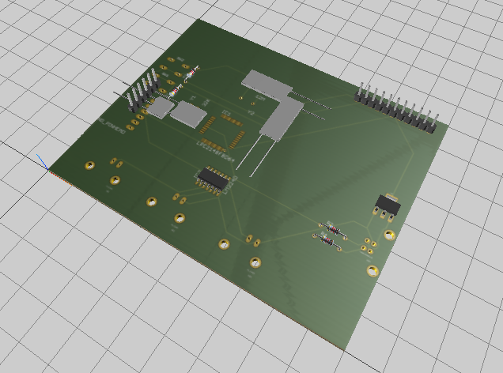
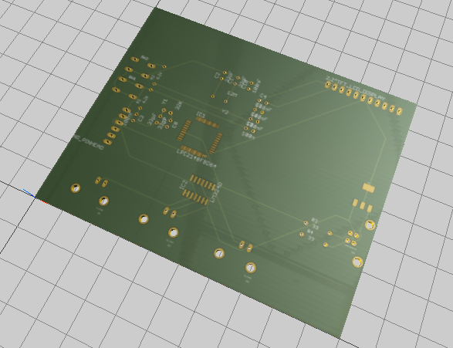
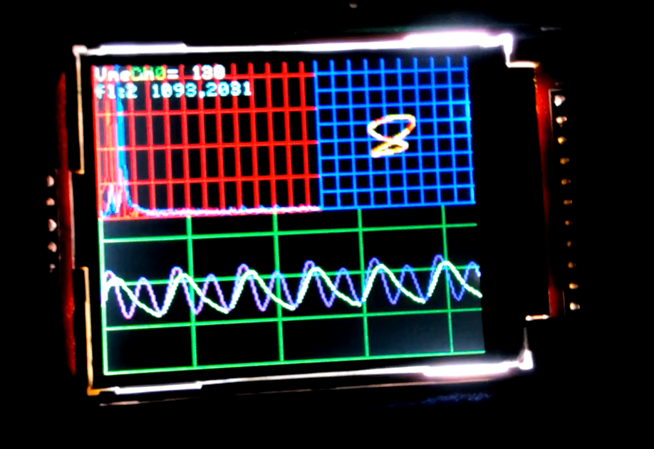
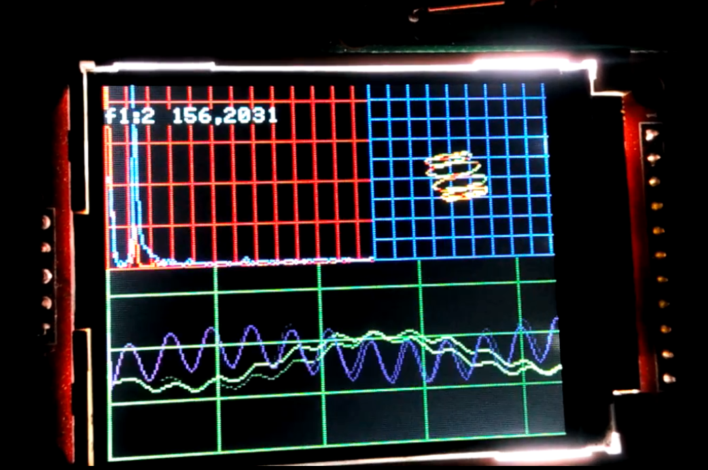

DIGITAL OSCILLOSCOPE …Electrical Engineer’s Stethoscope
Ajinkya Gorad , 2nd year undergrad (Electrical Engineering) , IIT Bombay
OBJECTIVE
SNAPS IN TIME
Creating a cheap & small oscilloscope for student use.
Prototype 0
Signal Acquisition & Display ( LCD display optimization)
Spectrum
Processing on Raw data (FFT) for Spectrum
Optimization
Making it pretty and optimizing for faster refresh rate
X-Y plot
Adding X-Y Plot without compromising much of performance
SPECIFICATION
Dual Channel simultaneous measurement with function generator
Battery Powered design
Displays Waveform, Spectrum, and X-Y Plot simultaneously captured with 10 bit accuracy ADC (Analog to Digital Converter)
Software adjustible parameters
sampling frequency and voltage grid
Type of window for Fast Fourier Transform (FFT)
type of Spectrum plot ( linear or log)
Software defined function generator with internal DAC (Digital to Analog Converter)
Input buffering to avoid damage to the oscilloscope
Sampling rate software adjustable to 200KHz
FUNCTIONAL BLOCK DIAGRAM
Snapshot of oscilloscope working with input sinusoid given from its function generator
FUTURE WORK / IDEAS
Adding Knobs for Controlling Sampling rate and Zooming in the waveform for more flexible control
Including on board storage and USB connection for data logging
Adding flexible input circuitry
Design on PCB to reduce further cost and size
SOFTWARE / HARDWARE
Software written in embedded C++ on ARM7 LPC21xx processor family with OOP (Object Oriented Programming)
Used 2.2” TFT LCD display
Programmed using inbuilt UART Bootloader on LPC ARM
Code & Circuit Schematics available at Github repository
Current hardware cost estimates less than 2000INR
Flowchart depicting a simplified processing method
RESOURCES
FFT algorithm http://staff.science.nus.edu.sg/~phywjs/CZ5101/fft.c written by Wang Jian-Sheng.
Project source at https://github.com/ajinkyagorad/LPC_2148_OSCLLOSCOPE
Contact Mail : ajinkyagorad@gmail.com

